Slide 1
INTRODUCTION TO LANGUAGE TECHNOLOGIES
Prepared by:
1-Mohamed Yousri Ibraheem Abdallah. (ID: 20221509866)
2-Abdulrahman Salah Anwar Abdo. (ID: 20221458503)
3-Abu-Bakr Mohamed Mahmoud Ragab. (ID: 20221458962)
Topic Name: TEXT PROCESSING
Supervised By:
Prof. of Computational Linguistics and Head of Phonetics and Linguistics Dept.
Dr. Sameh Alansary
كلية الحاسبات و علوم البيانات

Slide 2



Team Members
كلية الحاسبات و علوم البيانات
الاسم: عبدالرحمن صلاح أنورعبده.
الرقم لجامعي: 20221458503
الرقم القومي: 30306250201075
الفرقة: الثانية
الاسم: محمد يسري إبراهيم عبدالله.
الرقم لجامعي: 20221509866
الرقم القومي: 30206150201294
الفرقة: الثانية
الاسم: أبوبكر محمد محمود رجب.
الرقم لجامعي: 20221458962
الرقم القومي: 30309130202093
الفرقة: الثانية

Slide 3
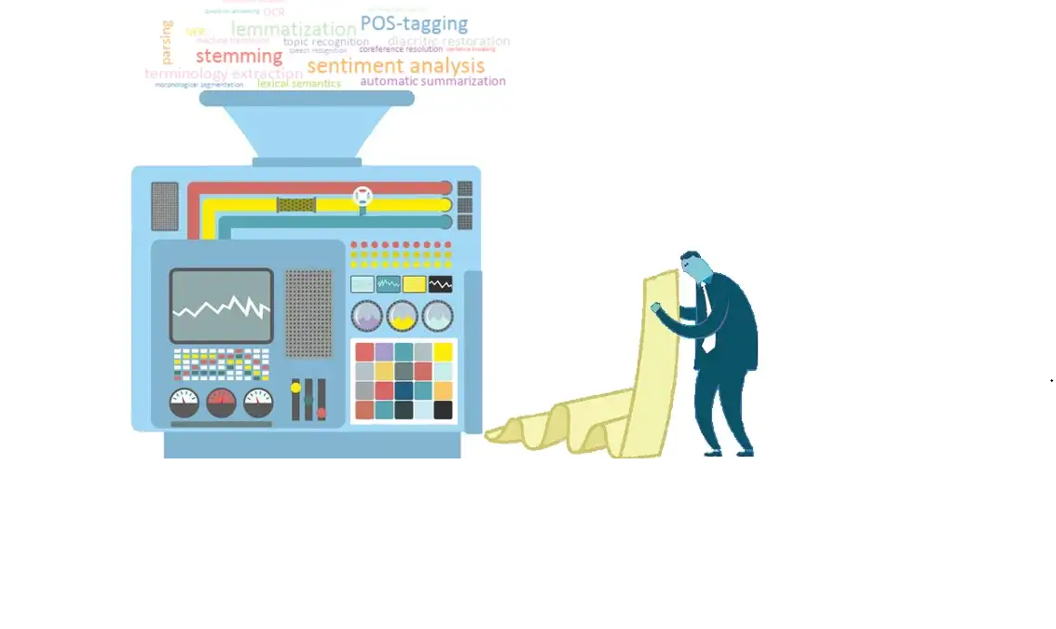
Text Processing

Slide 4

01
INTRODUCTION
02
Review Of Literature
03
Methods and Tools
OUTLINE
04
Opportunities and Challenges
05
Applications
06
Discussion
07
Conclusion
08
References and Sources

Slide 5






CONTENET OVERVIEW
03
OPPORTUNITIES AND CHALLENGES
06
WHAT WILL WE FACE?
04
CONCLUSION
01
APPLICATIONS
WHAT WE HAVE REACHED!
INTRODUCTION
USEES AND PURPOSES.
WHAT IS TEXT PROCESSING?
02
05
METHODS AND TOOLS
DISCUSSION
HOW IT WORKS?
EXAMINATION AND CONSIDERATION

Slide 6

What Is Text Processing ?
Text processing is the automated process of analyzing and sorting unstructured text data to gain valuable insights.

Slide 7

How AND WHY to Extract Valuable Text ?
Using natural language processing (NLP) and machine learning, subfields of artificial intelligence, text processing tools are able to automatically understand human language and extract value from text data.

Slide 8
Statistical Methods
1
METHODS AND TOOLS
TEXT CLASSIFICATION
2
3
TEXT EXTRACTION

Slide 9
Statistical Methods
1
At the heart of text processing are math and statistics. From frequency distribution, collocation, concordance, and TF-IDF, you can make use of all these statistical methods to process and analyze text.

Slide 10
2
TEXT CLASSIFICATION
Text classification classifies text into pre-defined groups based on its content, helping businesses to automatically sort and analyze their textual information.

Slide 11
3
TEXT EXTRACTION
Text extraction is a text processing technique that identifies and obtains valuable pieces of data that are present within the text. From keywords, client names, product details, dates, prices, or any other information within data, text extraction gets the job done.

Slide 12

OPPORTUNITIES AND CHALLENGES
STATISTICAL METHODS
TEXT CLASSIFICATION
TEXT EXTRACTION
1
2
3
WORD FREQUENCY
COLLOCATION
CONCORDANCE
TF-IDF
TOPIC ANALYSIS
SENTIMENT ANALYSIS
INTENT DETECTION
LANGUAGE CLASSIFICATION
KEYWORD EXTRACTION
ENTITY EXTRACTION

Slide 13
1-Statistical Methods
1
WORD FREQUENCY
This statistical method pinpoints the most frequently used words or expressions in a specific piece of text.
With this particular insight, you can address problematic situations, identify success areas, and more.

Slide 14
2
COLLOCATION
This method helps identify words that co-occur – meaning they commonly appear together.

Slide 15
3
CONCORDANCE
Concordance is all about providing context – in essence, it helps decode the ambiguity of human language by analyzing how specific words are used in different contexts.

Slide 16
For example, the word issue might be used for numerous scenarios such as a problem, a situation, a topic, or the act of supplying something:
There’s an issue with my account → problem
We have an issue to deal with → situation
It’s an important issue → topic
Your tracking number has been issued → supplied

Slide 17
4
TF-IDF
TF-IDF (term frequency-inverse document frequency) is a statistical measure that evaluates how important a word is to a document in a collection of documents.

Slide 18
For example:
The words ‘the’ or ‘and’ usually appear quite frequently in all documents, so they are not very useful for identifying the unique topics or themes discussed in a set of documents.
Therefore, The ‘uniqueness’ of the word may provide some useful information to understand what that specific document is talking about.

Slide 19
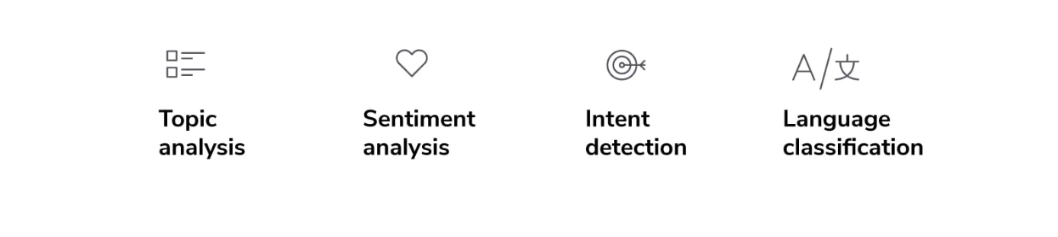
2-Text Classification Methods

Slide 20
1
TOPIC ANALYSIS
Topic analysis is a technique that interprets and categorizes large collections of text according to individual topics or themes.

Slide 21
2
SENTIMENT ANALYSIS
Sentiment analysis automatically detects the emotional undertones of customer reviews, survey responses, social media posts, and so on.
This sort of data helps companies learn and understand how customers feel about their brand, product, or service.

Slide 22

For example: sentiment analysis of Twitter data can help a company understand if customers are generally happy or angry with their brand or service. Take this tweet about Southwest:
This is clearly a negative tweet, and there are likely to be many other negative tweets mentioning the airline.

Slide 23
Sentiment analysis benefits:
👍
Quickly detect negative comments & respond instantly
👍
Take on 20% higher data volume
👍
Monitor sentiment about your brand, product, or service in real time
👍
Improve response times to urgent queries by 65%

Slide 24
3
INTENT DETECTION
Intent classification automatically unearths the intent, goal or purpose behind text.
This is particularly useful because it lets businesses know exactly where a user or lead is on their buyer journey.

Slide 25
4
LANGUAGE CLASSIFICATION
Language detection models classify text based on language.
A language detection model can automatically detect language for each text and route it to the appropriate localized teams.

Slide 26
3-Text Extraction
1
KEYWORD EXTRACTION
Keyword extraction automatically detects and extracts the most relevant words or expressions in text.

Slide 27
2
ENTITY EXTARCTION
Entity extraction automatically obtains names of people, companies, brands, and more.
It is particularly helpful when you’re trying to single out the names of competitors, brands, and people that influence your business to a certain extent.

Slide 28
Text Processing Use Cases and Applications
Customer Service
Customer feedback
Applications
Text processing helps businesses automate processes and obtain valuable insights from data.
This ultimately leads to better decision-making practices.

Slide 29

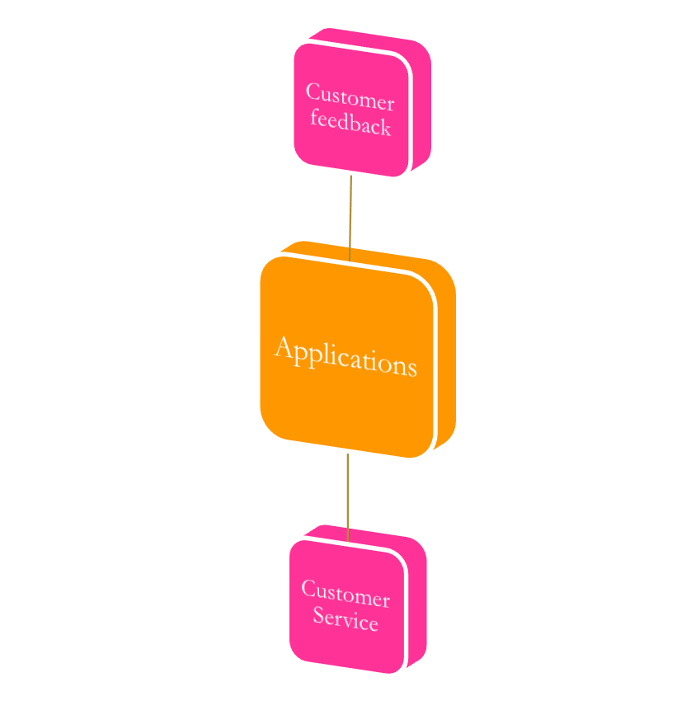
APPLICATIONS
CUSTOMER FEEDBACK
CUSTOMER SERVICE
1
2
Analyze Customer Surveys.
Analyze Product Reviews.
Automatically Tag Support Tickets.
Route And Triage Support Tickets.
Detect The Urgency Of A Ticket.

Slide 30


CUSTOMER FEEDBACK
1
Customer feedback is a key ingredient in any business strategy because it lets your customers know that you value their opinion.

Slide 31


1-Analyze Customer Surveys
used by businesses to measure customer satisfaction, and typically asks your customers to rate your business on a scale of 0-10.

Slide 32

As an Example:
You can use sentiment analysis technique to determine whether data is positive, negative or neutral.
Sentiment analysis is often performed on textual data to help businesses monitor brand and product sentiment in customer feedback and understand customer needs.

Slide 33

2-Analyze Product Reviews
Product reviews are like a compass that steer customers towards or away from products.

Slide 34


CUSTOMER SERVICE
2
Customer service is all about strengthening relationships and boosting customer loyalty.
Customer service teams deal with tons of customer queries, and with text processing you can automate processes so support agents can save precious time that could be better used to helping customers.

Slide 35


1-Automatically Tag Support Tickets
When customers send a request, ask about a product or service, or complain about an issue or bug, this information needs to be processed and handled.
Processing support tickets is important to make sure the appropriate team takes ownership and handles the issue promptly and accurately.

Slide 36

2-Route and Triage Support Tickets
Once support tickets have been tagged, you’ll be able to route issues to the right person in real-time, reducing response times and making teams more efficient.
Classifiers can help your business automatically route tickets by topic, language, urgency, and more.

Slide 37
How Can Automated Ticket Routing Help Your Customer Service Team?
AI-equipped tools can help you improve your customer service workflows, by automating routine tasks like ticket routing.

Slide 38
Some of the greatest advantages of automated ticket routing are:
1-Increased efficiency and productivity.
2-It saves time and reduces costs.
3-Improved satisfaction for customer service agents and customers.

Slide 39
1-Increased Efficiency and Productivity
Support tickets are instantly routed to the most appropriate person or team, significantly shortening response and resolution times.
Also, using machine learning to triage tickets is more objective and accurate than manual triaging since these tools apply the same criteria to all your tickets without hesitation, avoiding errors and inconsistencies.

Slide 40
2-Saves Time and Reduces Costs
Manually tagging and routing tickets is time-consuming and, therefore, expensive, especially when you have to deal with large volumes of tickets every day.
Automated ticket routing, on the other hand, is able to handle tickets at scale. You’ll just need to implement your machine learning tools once, and you’ll be able to analyze tons of tickets in real-time and in no time at all.

Slide 41
3-Improved Satisfaction For Customer Service Agents And Customers.
Automated ticket routing saves your client's valuable time.
By automating routine and boring tasks, customer service reps can dedicate more time to actual human interactions and connect to customers on an emotional level.

Slide 42

3-Detect the Urgency of a Ticket
The ability to prioritize tickets based on urgency has a positive impact on your business.

Slide 43

Discussion
What Is the reaction of companies receiving a lot of row text data?
companies receive a lot of raw text data via emails, chat conversations, social media, and other channels. This unstructured data is filled with insights and opinions about different topics, products, and services, but companies first need to organize, sort, and measure textual data to access this valuable information.

Slide 44

Can Text Data Be Processed Manually?
No, it can not be processed manually as text data nowadays are too big.

Slide 45


CONCLUSSION
WHY MACHINE LEARNING AND ARTIFICIAL INTELLIGENCE ARE IMPORTANT FOR TEXT PROCESSING?

Slide 46

Text processing with machine learning enables you to extract these insights easily and quickly in various ways.

Slide 47

You could use a keyword extractor to identify the most common expressions in survey responses.

Slide 48
On the other hand, Machine learning helps in topic classification and can categorize information based on topic, helping you to understand what topics or aspects customers mention the most.

Slide 49


RESOURCES:
https://monkeylearn.com/blog/text-processing/
https://www.sciencedirect.com/science/article/pii/S2589004221001231
https://monkeylearn.com/sentiment-analysis/
https://monkeylearn.com/sentiment-analysis-online/
https://www.datarobot.com/blog/text-processing-what-why-and-how/

Slide 50


Prof. Sameh Alansary

